Slide 1
1. When Coal Plants Shut Down, What Happens Next?
Topic 5. When Coal Plants Shut Down
Chapter 1. Business Basics.
Unit 1. The Context of Business.
MXA101 – Introduction To Business
-By ManageX Academy

Slide 2
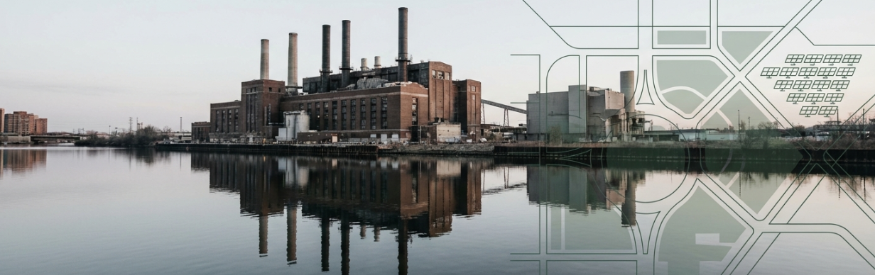
When Coal Power Plants Shut Down – The Business Question
Decline of coal-based power generation
Environmental, economic, and social implications
Shutdowns as a strategic business transition
Key question: What happens to these assets next?

Slide 3
Why Are Coal Plants Being Closed?
Aging infrastructure and high operating costs
Environmental and health concerns
Shift toward cleaner energy sources
Regulatory and public pressure

Slide 4
Location Matters – Urban vs Remote Plants
Older plants located near cities
Impact on dense residential areas
High land value and redevelopment potential
Community expectations after closure

Slide 5
Stakeholders Affected by Plant Closures
Local residents and communities
Employees and contract workers
Government and regulators
Power companies and investors

Slide 6
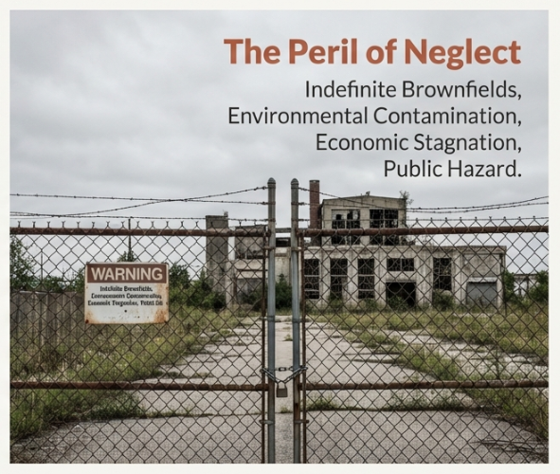
The Business Risk of Abandoned Industrial Sites
Idle sites turning into brownfields
Environmental uncertainty and liability
Loss of economic value
Reputation risk for companies

Slide 7
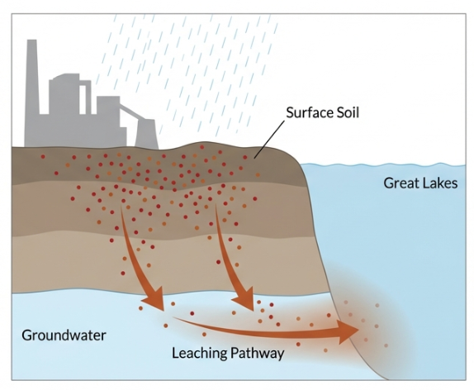
Environmental Due Diligence After Shutdown
Need for site assessment and testing
Soil, groundwater, and material risks
Importance of early remediation
Accountability of current owners

Slide 8
Regulatory Responsibility After Closure
Compliance with environmental laws
Monitoring and cleanup obligations
Financial risk of delayed action
Shared responsibility between business and government

Slide 9
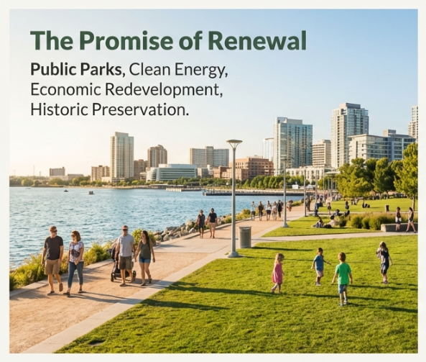
Redevelopment Opportunities – From Liability to Asset
Conversion into public parks and green spaces
Commercial and mixed-use development
Cultural or historical preservation
Infrastructure reuse potential

Slide 10
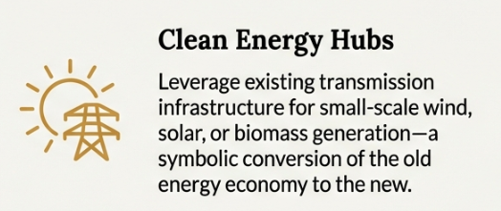
Clean Energy Transition on Old Sites
Solar power installations
Wind energy (location-dependent)
Biomass and alternative fuels
Grid connectivity advantage

Slide 11
Business Feasibility of Energy Conversion
Cost vs benefit analysis
Technology limitations
Market demand and policy incentives
Why some conversions fail

Slide 12
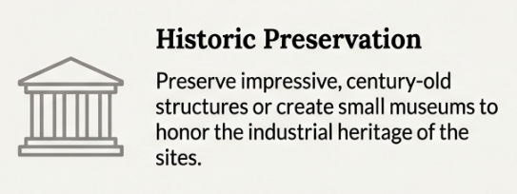
Environmental Risks of the Past
Legacy contamination concerns
Long-term impact of historical operations
Importance of transparency
Learning from past industrial mistakes

Slide 13
Community-Centric Redevelopment Strategy
Moral responsibility toward affected residents
Inclusion of local voices in planning
Social value creation
Long-term trust building

Slide 14
Strategic Lessons for Businesses
Closure is not the end of responsibility
Environmental planning is a leadership task
Sustainable transition protects brand value
Responsible exit strategies matter

Slide 15
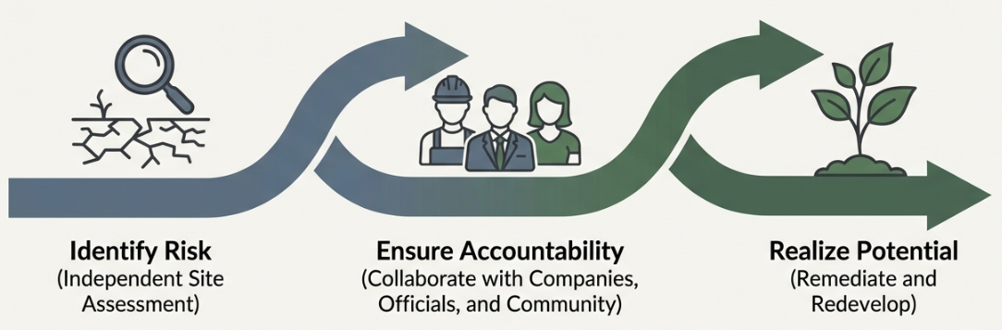
Key Takeaways for Managers & Leaders
Energy transition is inevitable
Business decisions have long-term social impact
Responsible redevelopment creates win-win outcomes
Future leaders must balance profit and purpose

Slide 16


